Slide 1
Detecting Fake vs Real News
Presented by The East-West Alliance:
Nicolas Carreras, Leticia Genao, Kevin Peng, and Molovi Shuba
Notes:
Leticia
Good morning! We are team TEWA - The East-West Alliance. I’m Leticia, *Nick Intro*, *Kevin intro*, *Molovi intro* and we’re solving the problem of identifying fake news in the media

Slide 2
Contents of this Presentation
01
06
07
02
08
03
09
04
10
05
11
12
Background Information
What is Fake News?
The Harm of Fake News
Model Comparison
Confusion Matrix
Problem Statement
Streamlit App
Modeling Goals
Conclusion of Findings
Overview of Data
Next Steps
Visualizations
Top Words
Bi-Grams
Spikes in Fake News
Patterns in Words
Future Improvements
Sources
Notes:
Leticia
A brief overview of what you will hear today: we will define what is fake news, the problem we’re trying to solve, and our ultimate goals. We’ll next step into some visualizations and identifying patterns in the fake dataset we found then move on to modeling, our application, and our final results. So let’s get started!

Slide 3
01
Background Info:
What is Fake News?
Why is it harmful?
Notes:
Leticia
First, let’s define what Fake News is and why the spread of it is harmful

Slide 4
Background Information: What is Fake News?
Fake news fabricated from bits of truth built with intent to mislead readers into believing a false narrative
Conspiracy theories disguised as authentic real news
Rumors sold as stated fact
Articles written in satire/parody that could mislead readers
Extremely biased political propaganda with fact distortion
Aliens are real! Mermaids exist! Santa Claus ate the cookies! The tooth fairy came! Aliens are real! Mermaids exist! Santa Claus ate the cookie
Notes:
Leticia
Fake news comes in a variety of formats
It takes a bit of truth or a fact but spins that fact into a false narrative
Conspiracy theories disguised as real new
Rumors sold as stated fact to the public
Satire articles that could mislead readers into thinking the news is real
And lastly, extremely biased political propaganda with fact distortion.
These categories were defined by Daniel Sieradski's BS Detector - a browser extension that detects fake news by these definitions

Slide 5
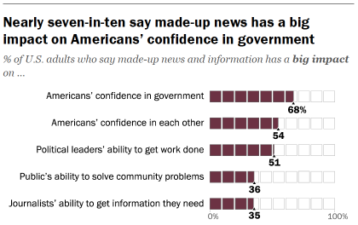
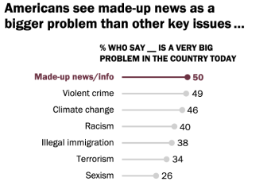
Background Information: The Harm of Fake News
Americans ranked fake news as a bigger problem than violent crime, climate change, racism, terrorism, and sexism.
60% of Pew Research survey respondents admitted to accidentally sharing fake news
70% say fake news has an impact on their confidence in the government
54% say they lose confidence in fellow Americans
Notes:
Leticia
Now, what is the harm of fake news? According to a survey done of 6,000+ Americans by Pew Research Data, Americans ranked fake news as a bigger problem than violent crime, climate change, racism, terrorism, and sexism in the country. 60% of respondents amitted so accidentally sharing fake news themselves and 70% believed fake news made them less confident in their government. 50% confessed they even lose confidence in their fellow Americans. Needless to say, the spread of misinformation can be extremely harmful and have a impact on the unity of our nation.
https://www.pewresearch.org/journalism/2019/06/05/americans-see-made-up-news-as-a-bigger-problem-than-other-key-issues-in-the-country/

Slide 6
02
Minimizing the Spread
Problem Statement,
Expectations, & Goals
Notes:
Leticia
Next, I’ll walk you through the methodology

Slide 7
Problem Statement
The Society of Professional Journalists hired The East-West Alliance (TEWA) as consultants to create a model that predicts and classifies articles as either fake or real based on the title and content of the news article.
The goal aims to mitigate the spread of misinformation and promote accountability in the media. It would help out social media sites like Facebook and Twitter to filter out spam and/or fake stories that would make a culpable person believe them and cause damage.
Notes:
Leticia
Read verbatim

Slide 8

Modeling Goals
Test various machine learning models to correctly classify if the political article is fake news or real news.
Identify patterns in fake data
Reduce likelihood of incorrectly labeled real news (false negatives)
Use model with best sensitivity and metrics to analyze the latest news articles
Build an application to test text input and verify if the news article is real or not.
Notes:
Leticia
To implement our problem statement we will test various models to correct classify if the political article is fake or real news
We aimed to identify patterns in the fake data
We will use the best model with the best sensitivity score since we care about identifying false negatives or correctly identifying fake news as fake
Lastly, we wanted to build an app for users to test text input and verify if it is true or fake

Slide 9
03
Data Overview
Where did we find the fake/real news?
Notes:
Leticia
Next, a brief data overview

Slide 10
Overview of Data
Description
Combined a labeled Kaggle dataset (2016-2019) with several collected labeled datasets (2007-2020) to create a unique 13 year dataset
Initial Columns
Title: The title of the article
Text: The text of the article
Subject: The category of the news
Date: The date the article was posted
Feature Engineering
Clean Text: The preprocessed and cleaned text that was the final feature for the model
Uncleaned: 44,898 + 63,062 = 107,960
Cleaned/lemmatized: 38,584 + 39,282 - 28 = 77,838
52% Fake
48% Real
Total Rows
Notes:
Leticia
The initial dataset used was a compilation of true and fake news from 2016-2019 and we found additional data from a wider date range of 2007-2020 to make a more robust model.
The initial dataset columns were the title, text, subject, and data of the article and the final feature we used in our model was a column of clean text we developed after processing.
Prior to cleaning our initial and additional data totaled 107K, and after cleaning, dropping nulls, and lemmatizing we had 77K rows of 52% fake news so our data was pretty balanced.
Next, I’ll hand it over to Nick to go over our EDA and pattern recognition
Politicalfact.com - finds fake news article and statements from a variety of web sources and debunks/verifies them
. fake news flagged by Politifact.com from 2016, truthful articles crawled from Reuters from 2016-2017 collected by Ahmed H, Traore I, Saad S

Slide 11
04
Data Visualizations
What patterns are there in the data?

Slide 12
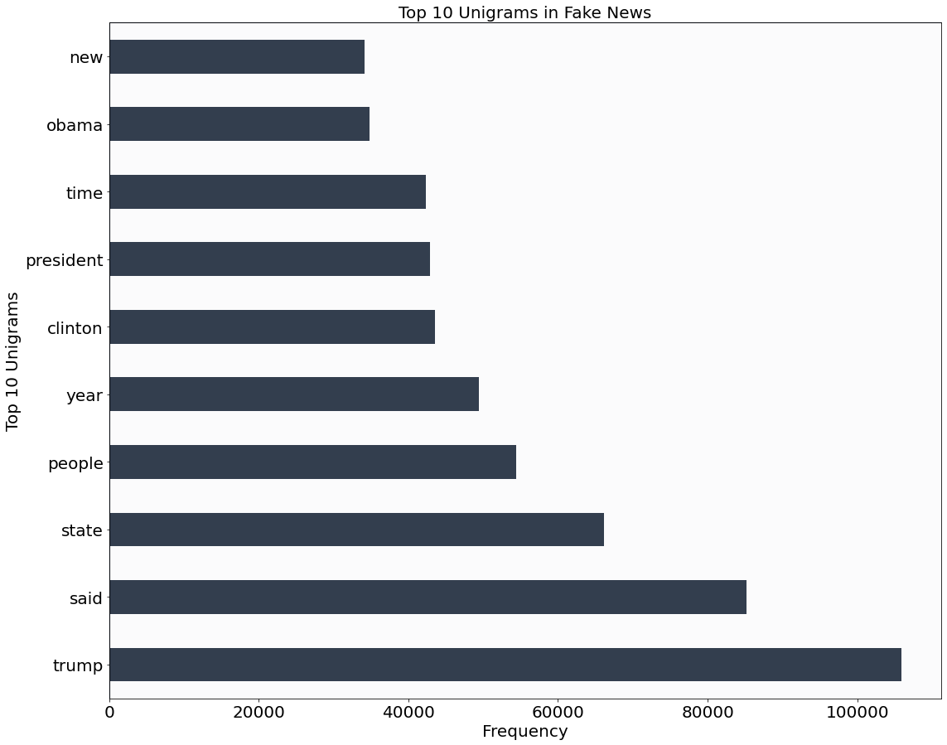
Visualizations: Top Fake Words
Top Words
Trump
Said
State
People
Year
Clinton
President
Time
Obama
New
Notes:
Initial dataset

Slide 13
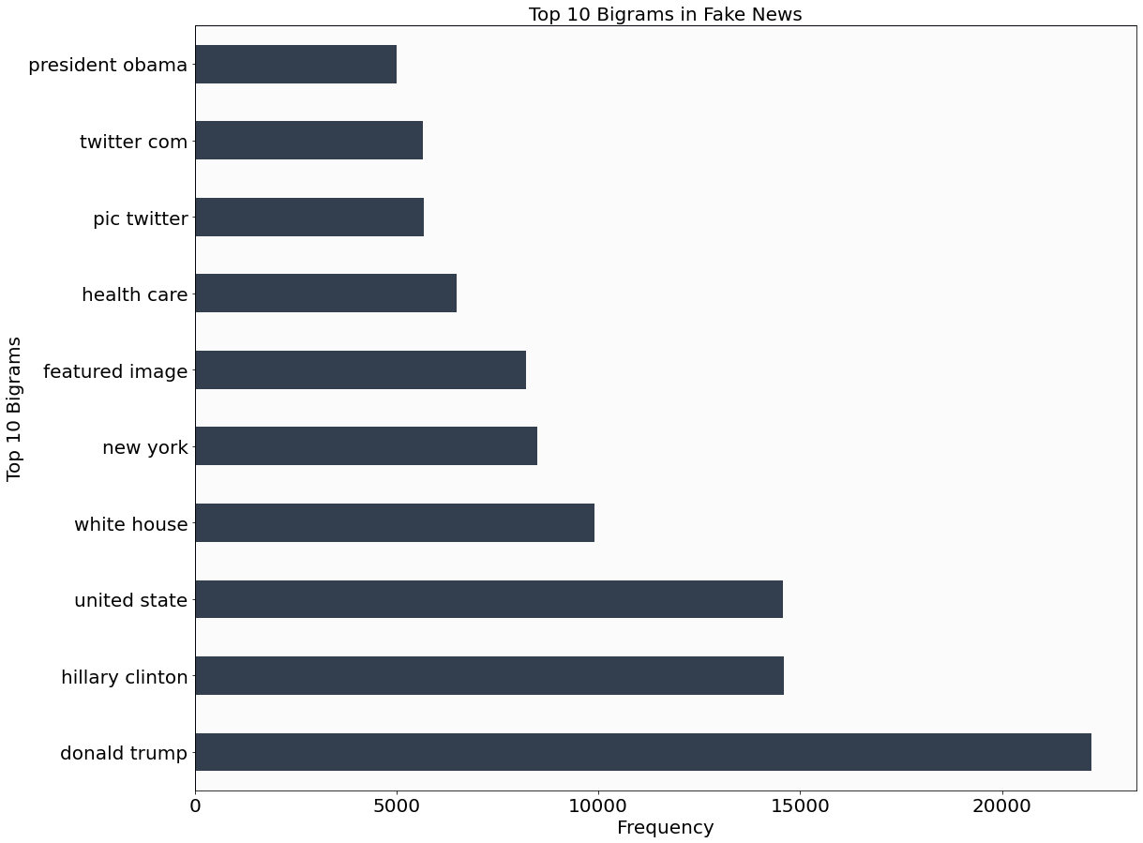
Visualizations: Top Fake Bi-Grams
Top Bi-Words
Donald Trump
Hillary Clinton
United States
White House
New York
Featured Image
Health Care
Pic Twitter
Twitter Com
President Obama
Notes:
Initial dataset

Slide 14
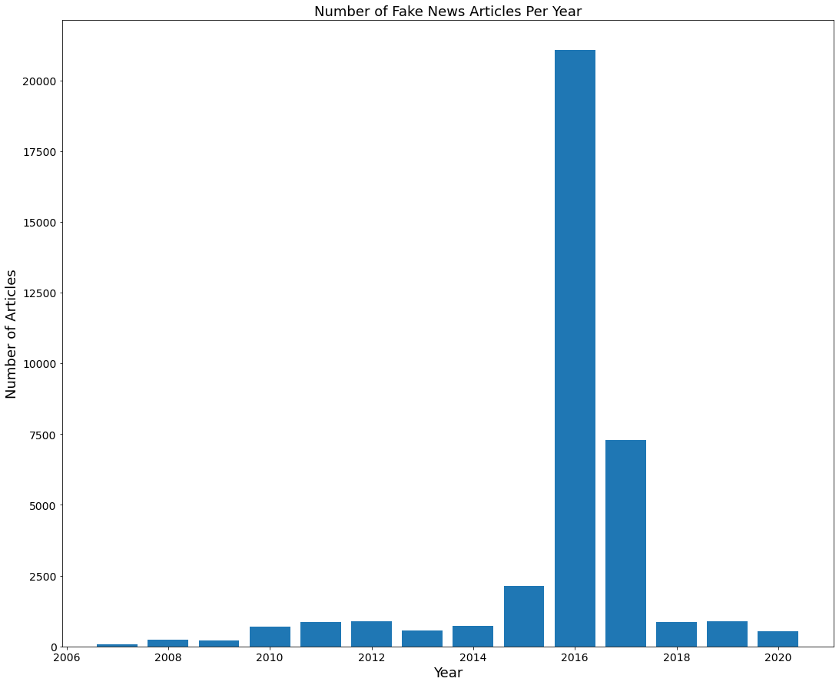
Visualizations: Fake News over Time
2016 Election
The biggest spike of fake news occurring during Trump’s election in 2016
Notes:
“A much higher amount of U.S. respondents believed that fake news also impacted general elections, and 70% were convinced fake news influenced the 2020 presidential election.”
https://www.forbes.com/sites/forbestechcouncil/2021/03/26/buzzword-or-real-threat-fake-news-is-more-dangerous-than-you-think/?sh=60c12f043a5f

Slide 15
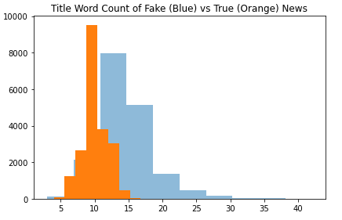
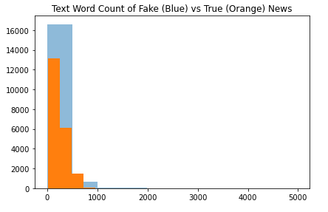
Visualizations: Pattern in Words
Frequency
Fake News have longer titles and texts than real news

Slide 16
04
Streamlit App
Let’s test for the truth!
Notes:
MOLOVI
Before we show you our models performance…Lets showoff our app to you.
We will test 2 or 3 news article in our app against a few different types of machine learning model!

Slide 17
You Check! - Streamlit App
Article 1
Article 2
Mike Haridopolos says 'many states' are floundering under crushing deficit spending (tampabay.com)
Mike Haridopolos says 'many states' are floundering under crushing deficit spending
Illegal Alien Crime Accounts for Over 30% of Murders in Many States
VS
Notes:
MOLOVI—----
Explain what streamlit is and why it’s useful
Input fake and real test articles
Poll first then run app
Streamlit:
A faster way to build and share data apps
Streamlit turns data scripts into shareable web apps in minutes.
Fake news:
Mike Haridopolos says 'many states' are floundering under crushing deficit spending (tampabay.com)
(REMINDERR THIS ARTICLE YOU SENT 2/6 OF THE ML MODELS CAPTURED IT RIGHT WHICH WAS SVC AND DT
)
Illegal Alien Crime Accounts for over 30% of Murders in Many States
Republican presidential candidate Donald Trump deserves credit for forcing all 17 Republican candidates to talk about the social costs of illegal immigration, but it is not “Trump’s issue.” We will be making a fatal mistake if we let the media discuss it that way.
As Ann Coulter has pointed out, this is the most critical issue of the 2016 race because this is the issue that will define whether or not there will even be an American nation recognizable as the “home of the free and land of the brave.”
But illegal immigration is not “Ann Coulter’s issue” any more than it is “Tom Tancredo’s issue.” It is America’s issue — not only because it will define America in the 21st Century but because it also defines American elections and who will be voting in elections in 2020 and beyond. It also illuminates the power of the mainstream media to keep issues off the national stage.
Think of illegal immigration this way: If the liberal media can keep illegal alien crime out of the “kitchen table debate,” they can keep any issue out of the debate. And they will if they can get away with it. For those reasons, illegal immigration is much more than an issue of public policy; it is the poster child for media malpractice.
The media’s attempt to suppress public awareness over illegal alien crime and the effects of illegal immigration on American workers’ jobs and wages is nothing less than censorship on a massive scale. We need to start talking about it in those terms and hold the media accountable for the lack of ethical standards.
The mainstream media – including, sadly, major segments of the presumably conservative media, like the Wall Street Journal — are working overtime to keep the American public and the American voters in the dark on the scope of illegal alien crime. The murder of Kate Steinle in San Francisco exposed only the tip of a massive iceberg, and the media establishment is desperate to avoid dealing with the iceberg underneath.
Let’s look at a few numbers. You haven’t seen them in the New York Times, Atlanta Constitution, or the Miami Herald, nor have they been featured on NBC Nightly news or CNN. So, the average American is blissfully unaware of them.
Between 2008 and 2014, 40% of all murder convictions in Florida were criminal aliens. In New York it was 34% and Arizona 17.8%.
During those years, criminal aliens accounted for 38% of all murder convictions in the five states of California, Texas, Arizona, Florida and New York, while illegal aliens constitute only 5.6% of the total population in those states.
That 38% represents 7,085 murders out of the total of 18,643.
That 5.6% figure for the average illegal alien population in those five states comes from US Census estimates. We know the real number is double that official estimate. Yet, even if it is 11%, it is still shameful that the percentage of murders by criminal aliens is more than triple the illegal population in those states.
Those astounding numbers were compiled by the Government Accountability Office (GAO) using official Department of Justice data on criminal aliens in the nation’s correctional system. The numbers were the basis for a presentation at a recent New Hampshire conference sponsored by the highly respected Center for Security Policy. You can view the full presentation here:
Fake News Also:
https://www.breitbart.com/the-media/2015/08/08/illegal-alien-crime-accounts-for-over-30-of-murders-in-some-states/
only KNN got it wrong
Mike Haridopolos says 'many states' are floundering under crushing deficit spending
After some bumps and squabbling, Florida Senate President Mike Haridopolos and House Speaker Dean Cannon emerged from secret budget negotiations on April 26, 2011, to announce that they had reached the framework of a budget agreement.
The framework is just that -- the amounts of general revenue funding allocated to each budget area. The Senate and House must still agree on how, exactly, to spend that money.
Still, it was cause for celebration for both Haridopolos and Cannon, who issued a joint press release.
Said Haridopolos: "While many states and the federal government are floundering under crushing deficit spending, we kept our promise that we would not raise taxes or fees during these difficult economic times. For months, I've heard over and over again that we would never be able to get this done. Working as a team, the House and Senate reached these budget allocations on behalf of all Floridians."
PolitiFact Florida wondered if "many states ...floundering under crushing deficit spending?"

Slide 18
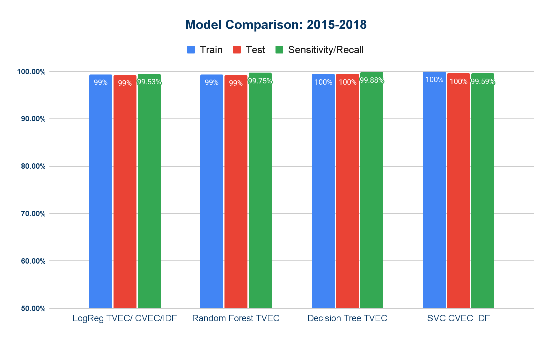
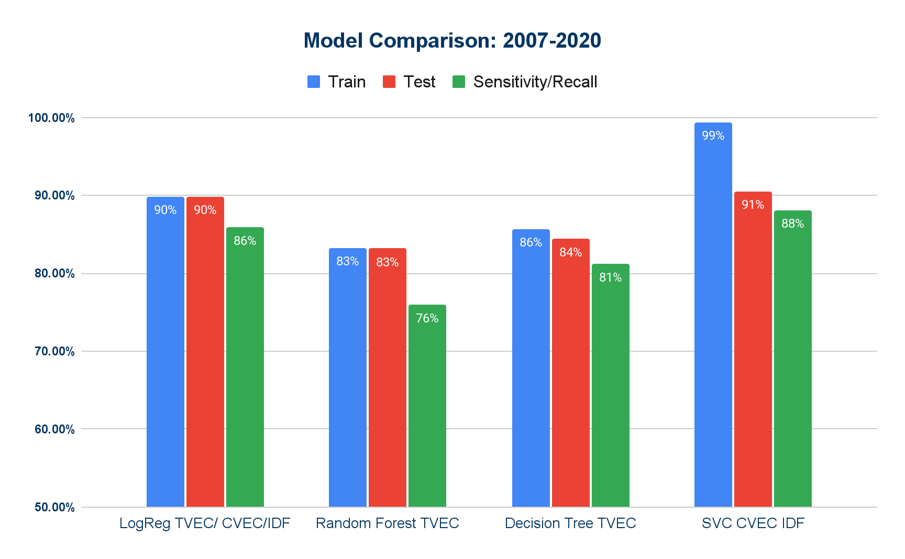
Model Comparison Ranked
Original Model
Reran Model
Notes:
What is our best model and why?

Slide 19
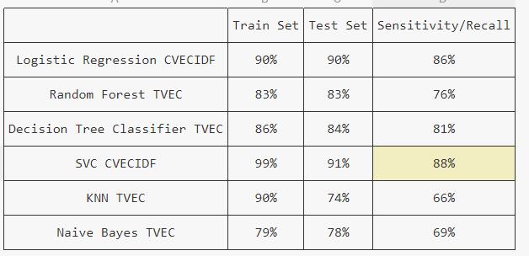
FINAL SCORES!!!

Slide 20
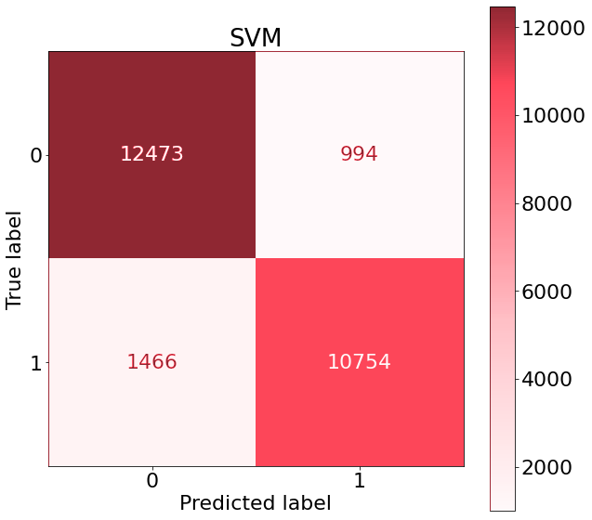
Confusion Matrix
99% Train
91% Test
88% Sensitivity
Notes:
MOLOVI-----
What is our best model and why? SVM () support vector classifier because it had the best sensitivity which we wanted to maximize for!!!
We are maximizing sensitivity (or recall) or in other words trying to reduce the amount of FALSE NEGATIVES our model gets!
We want to correctly classify false news more often then true news!
What we are looking at here:
True Negative | False Positive
----------------------------------------
False Negative | True Positive

Slide 21
05
Conclusion
&
Final Recommendations

Slide 22
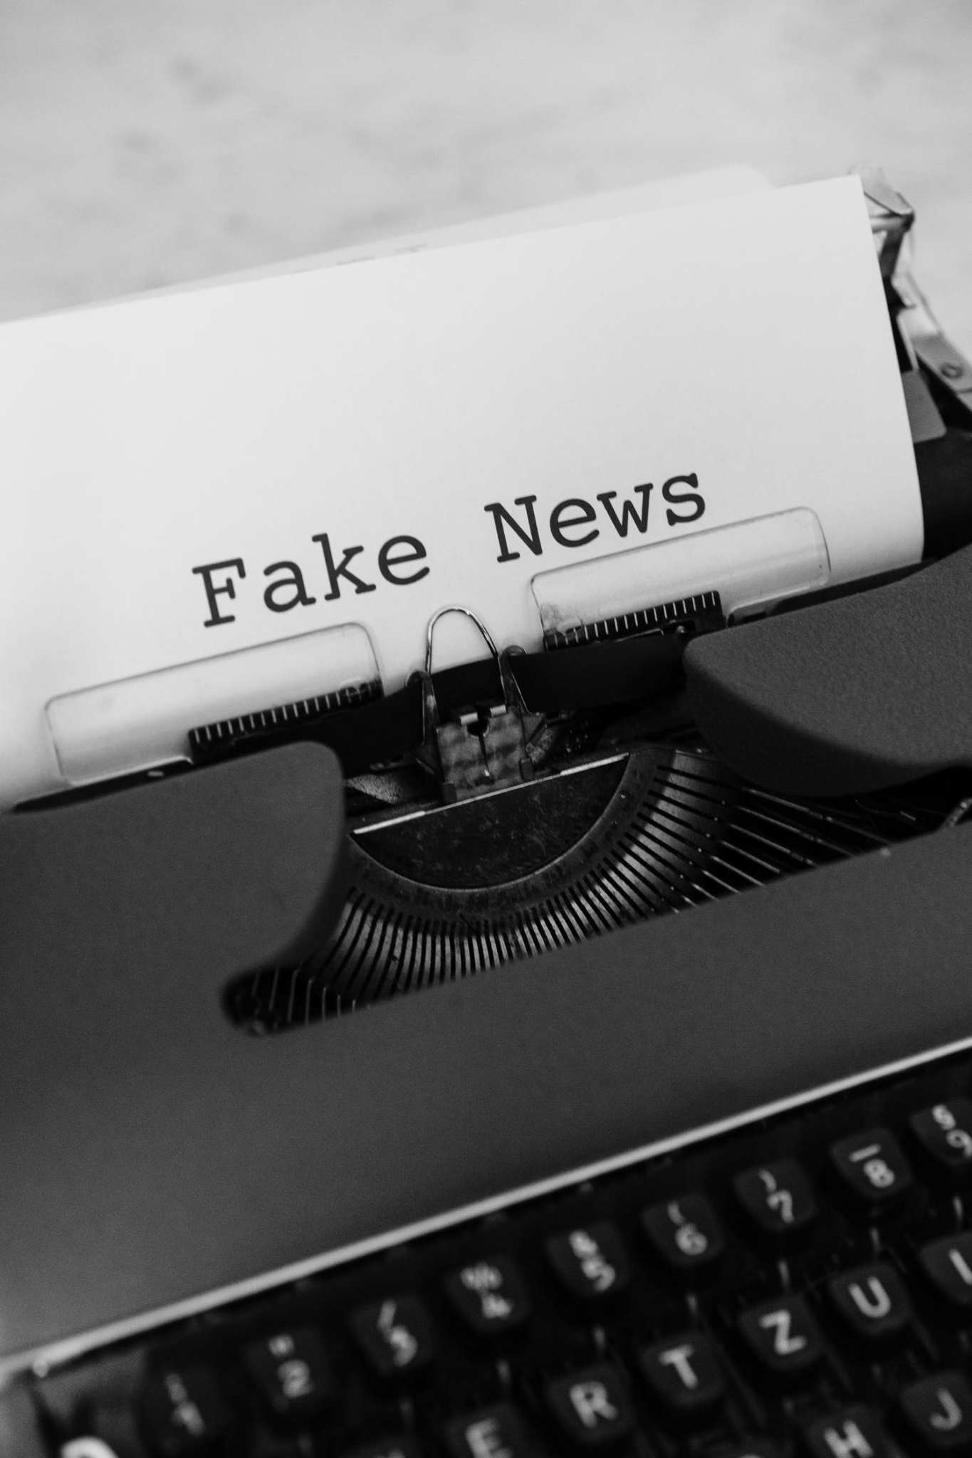
Conclusion of Findings
SVC was our final model with the most reliable and consistent results in catching fake news
The longer the text the more likely it is to be fake news
Consistent with public opinion fake news spikes during election period
“Said” is a strong indicator of real news

Slide 23

Next Steps
Rec 1
Update models quarterly from NEWs API site to maintain a rigorous model
Rec 2
Fine tune and maintain the classification app to meet user needs
Rec 3
More NLP Analysis and establish a custom word list
L I V E
TEWA - Your # 1 Source for Trusted Real News! TEWA - Your # 1 Source for Trusted Real News! TEWA - Your # 1 Source for Trusted Real News!
Notes:
Update model constantly – Get funding to use the NEWS API which cost to pull more then 100 data everyday

Slide 24

Future Improvements
Rec 4
Refine the preprocessing of text data using more advanced RegEx techniques
Rec 5
Further hypertune/experiment with other/more hyperparameters
Rec 6
Separate models for different subjects/topics
L I V E
TEWA - Your # 1 Source for Trusted Real News! TEWA - Your # 1 Source for Trusted Real News! TEWA - Your # 1 Source for Trusted Real News!
Notes:
More time - make app more user friendly with one final chosen model so they can test news
Rec2:
A weak
Degrading model because words change - special attention to election period…. News data in 2020 wouldnt be a strong predictor to classify news in 2025
The goal would be to automate this process where we have a python script to collect data from a News API to add onto our previous data which where it will be retrained
Rec3– maintaining the app. Tune it based on user needs and feedback
Add like a Clear button for app
Minimize to 1-3 final model
Aggregate predictions of all models and create final model from

Slide 25
TEWA
Thanks You!
Any Questions?

Slide 26
Sources:
H, T. I., & S, S. (2017, ). (2017) “Detection of Online Fake News Using N-Gram Analysis and Machine Learning Techniques. Retrieved 10618
Megan Risdal. (2016). <i>Getting Real about Fake News</i> [Data set]. Kaggle. https://doi.org/10.34740/KAGGLE/DSV/911
Rishabh Misra (2019). <i>News Category Dataset</i>[Data set]. Kaggle. https://www.kaggle.com/datasets/rmisra/news-category-dataset
Fariba Sadeghi, Amir Jalaly Bidgoly, Hossein Amirkhani. (2020). FNID: Fake News Inference Dataset. IEEE Dataport. https://dx.doi.org/10.21227/fbzd-sw81
Lans, S. van der. (2021, March 26). Council post: Buzzword or real threat? Fake news is more dangerous than you think. Forbes. Retrieved from https://www.forbes.com/sites/forbestechcouncil/2021/03/26/buzzword-or-real-threat-fake-news-is-more-dangerous-than-you-think/?sh=60c12f043a5f
Mitchell, A., Gottfried, J., Stocking, G., Walker, M., &amp; Fedeli, S. (2021, November 12). Many Americans say made-up news is a critical problem that needs to be fixed. Pew Research Center's Journalism Project. Retrieved from https://www.pewresearch.org/journalism/2019/06/05/many-americans-say-made-up-news-is-a-critical-problem-that-needs-to-be-fixed/
Notes:
https://www.uvic.ca/ecs/ece/isot/assets/docs/ISOT_Fake_News_Dataset_ReadMe.pdf
https://www.uvic.ca/ecs/ece/isot/datasets/fake-news/index.php?utm_medium=redirect&utm_source=/engineering/ece/isot/datasets/fake-news/index.php&utm_campaign=redirect-usage
https://www.kaggle.com/datasets/clmentbisaillon/fake-and-real-news-dataset
- our original data
https://www.kaggle.com/datasets/mrisdal/fake-news
- Fake2
https://www.kaggle.com/datasets/rmisra/news-category-dataset
-real2
https://ieee-dataport.org/open-access/fnid-fake-news-inference-dataset
-fnn
“ 60% of them admitted to sharing misinformation, not knowing it was fake news before they did”
“A much higher amount of U.S. respondents believed that fake news also impacted general elections, and 70% were convinced fake news influenced the 2020 presidential election.”
https://www.forbes.com/sites/forbestechcouncil/2021/03/26/buzzword-or-real-threat-fake-news-is-more-dangerous-than-you-think/?sh=60c12f043a5f
Statistics/Charts
https://www.pewresearch.org/journalism/2019/06/05/americans-see-made-up-news-as-a-bigger-problem-than-other-key-issues-in-the-country/

